Slide 1
IndusOS - Hackathon
Anushman Jadhav
Arun George
Raj Joshi
Sanchita

Slide 2
Problem Statement:
a) Given a user, when will he do his next balance recharge
b) The amount of the recharge
Columns: Unknown, Device-ID, Server Date, Local Date, Balance

Slide 3

Feature Engineering & EDA
No. of rows - 5cr
- Sampled random Data
- Missing & Null values
- DateTime to Day + Time
- Encode to Months

Slide 4
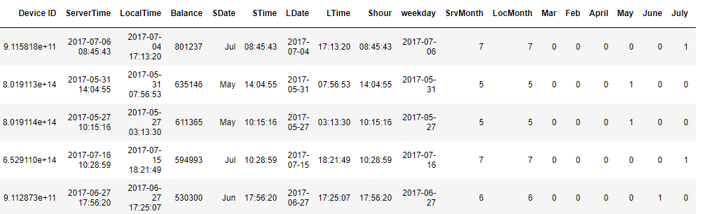

Slide 5
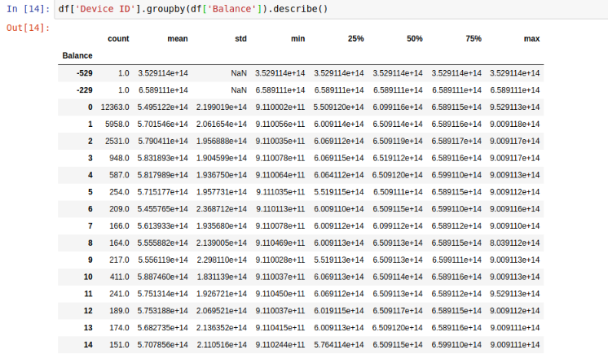

Slide 6
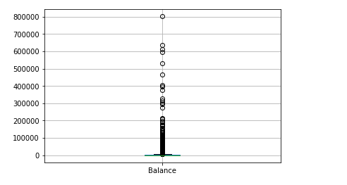
Boxplot for Balance on 25% of data

Slide 7
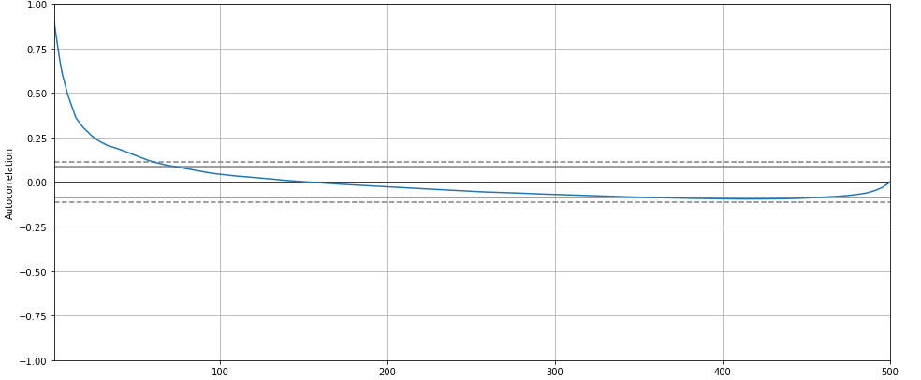
AutoCoreleation[‘Balance’]

Slide 8
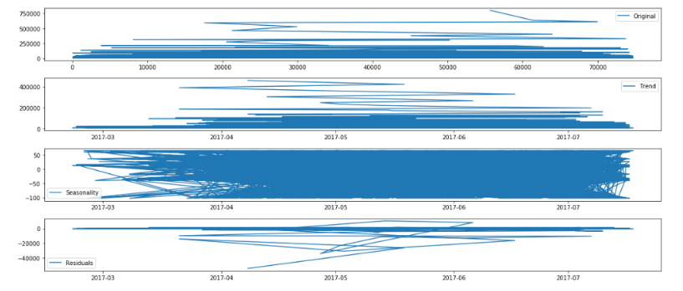
Seasonality, Trend

Slide 9
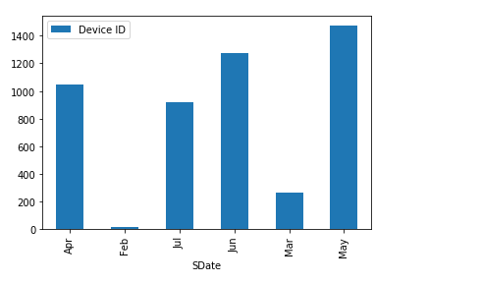
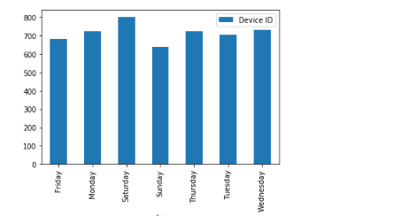
User recharge frequency

Slide 10
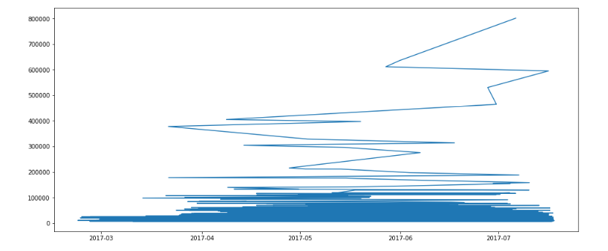
Using Adfuller test

Slide 11
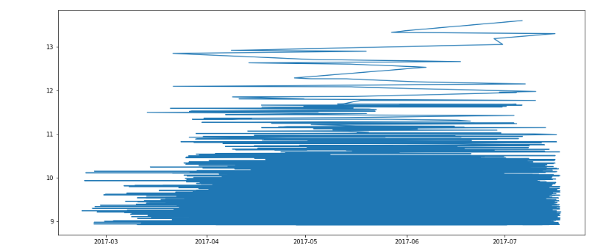

Slide 12
Next Step
Fitting - ARIMA
Getting Holiday Trends,Lag plots

